Slide 1
Result
Prompt

Slide 2
Prompt
examples
Impromptu prompt
Result
Data / Context
process

Slide 3
Prompt
examples
Impromptu prompt
Result
Data / Context
process

Slide 4
Prompt
examples
Impromptu prompt
Data / Context
Result
process

Slide 5
Prompt
examples
Impromptu prompt
Data / Context
process
Result

Slide 6
Prompt
examples
Impromptu prompt
Result
Data / Context
process

Slide 7
Prompt
examples
Impromptu prompt
Result
Data / Context
process

Slide 8
Prompt
examples
Impromptu prompt
Data / Context
Result
process

Slide 9

Prompt
examples
Impromptu prompt
Data / Context
Data / Context
Final Result
Human
Evaluation Edit Addition
process

Slide 10
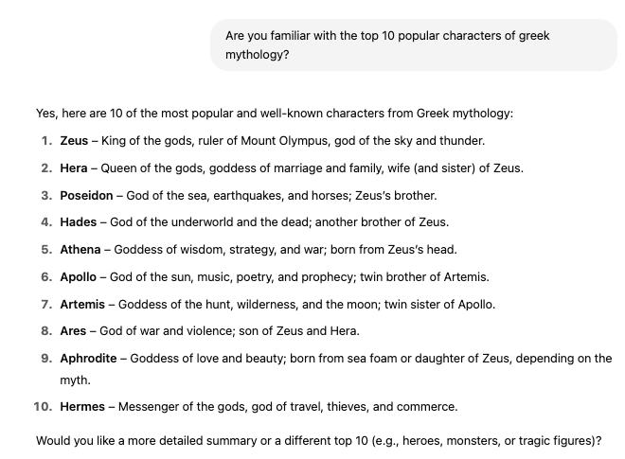
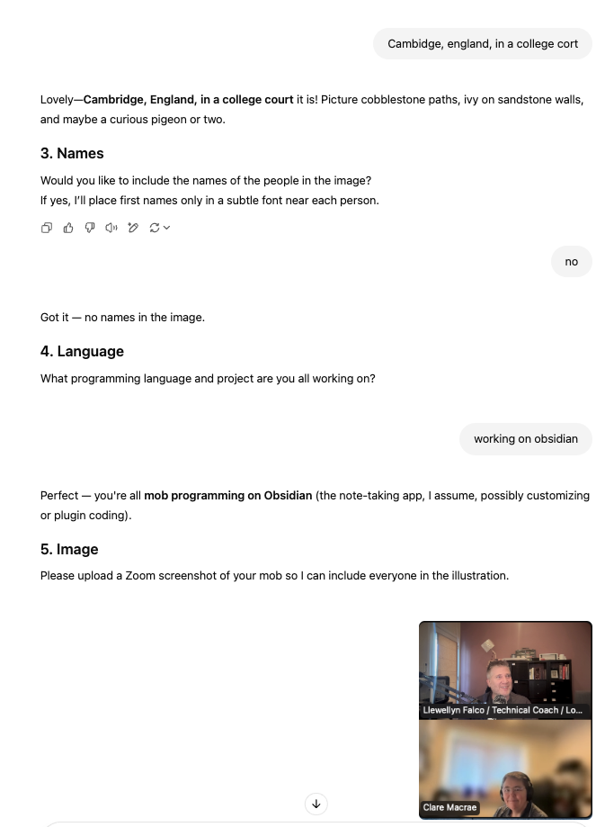
Data / Context
Pre-Heat
Interview me
Build a Doc
Diagram
Unit Test
Check List
✅ item 1
☐ item 2
☐ item 3

Slide 11
Prompt
examples
Impromptu prompt
Data / Context
Data / Context
process
Data / Context
Data / Context
Final Result

